Slide 1
CHAPTER 19
Logical Addressing
Part-1

Slide 2
IP Address
"IP" stands for Internet Protocol.
The Internet Protocol (IP) is the method or protocol by which data is sent from one computer to another on the Internet.
Each computer on the Internet has at least one IP address that uniquely identifies it from all other computers on the Internet.
An IP address is a unique global address for a network interface.

Slide 3
Cont.
IP by itself is something like the postal system. It allows you to address a package and drop it in the system, but there's no direct link between you and the recipient.

Slide 4
Cont.
Two (2) IP addressing standards are in use today. The IPv4 standard is most familiar to people and supported everywhere on the Internet, but the newer IPv6 standard is gradually replacing it.
  (1). IPv4 addresses consist of four (4) bytes (32 bits)
  (2). IPv6 addresses are sixteen (16) bytes (128 bits) long.

Slide 5
IPv4 Addresses
An IPv4 address is a 32-bit or 4 byte address that uniquely and universally defines the connection of a device (for example, a computer or a router) to the Internet.
An IPv4 address consists of four numbers, with a single dot (.) separating each number or set of digits.
Each of the four numbers can range from 0 to 255.
8 bit | 8 bit | 8 bit | 8 bit

Slide 6
Address Space
An address space is the total number of addresses used by the protocol.
If a protocol uses N bits to define an address, the address space is 2^{N} because each bit can have two different values (0 or 1) and N bits can have 2^{N} values.
IPv4 uses 32-bit addresses, which means that the address space is 2³² or 4,294,967,296 (more than 4 billion).

Slide 7
Notations
There are two prevalent notations to show an IPv4 address:
  (1) Binary notation.
  (2) Dotted decimal notation.
Binary Notation:
01110101 10010101 00011101 00000010
Dotted-Decimal Notation: 117. 149. 29. 2
Binary Notation: | 01110101 | 10010101 | 00011101 | 00000010
Dotted-Decimal Notation: | 117. | 149. | 29. | 2

Slide 8
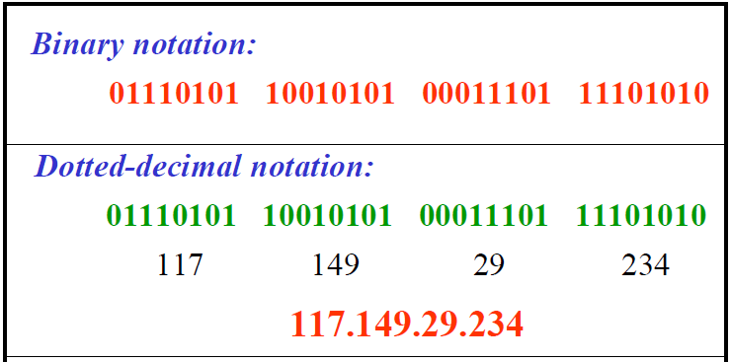
Cont.

Slide 9
Wrong ip
There must be no leading zero (027).
There can be no more than four numbers in an IPv4 address.
Each number needs to be less than or equal to 255.
A mixture of binary notation and dotted-decimal notation is not allowed.

Slide 10
Example
111.56.045.78
  There must be no leading zero (045).
b. 221.34.7.8.20
  There can be no more than four numbers in an IPv4 address.
c. 75.45.301.14
  Each number needs to be less than or equal to 255 (301 is outside this range).
d. 11100010.23.14.67
  A mixture of binary notation and dotted-decimal notation is not allowed.

Slide 11
Classful Addressing
IPv4 addressing, at its inception, used the concept of classes. This architecture is called classful addressing.
In classful addressing, the address space is divided into five classes: A, B, C, D, and E.
Class | Binary | Decimal
A | 0 | 0-127
B | 10 | 128-191
C | 110 | 192-223
D | 1110 | 224-239
E | 1111 | 240-255

Slide 12
Cont.
Class | Start address | End Address
A | 0.0.0.0 | 127.255.255.255
B | 128.0.0.0 | 191.255.255.255
C | 192.0.0.0 | 223.255.255.255
D | 224.0.0.0 | 239.255.255.255
E | 240.0.0.0 | 255.255.255.255

Slide 13
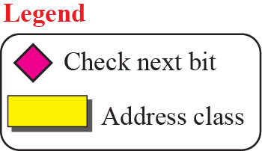
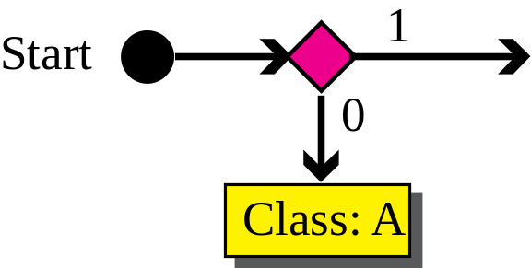
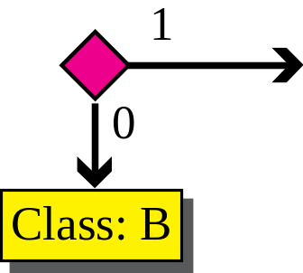
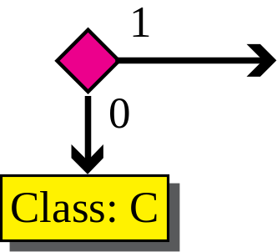
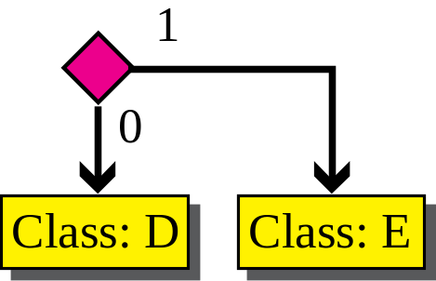
Cont.

Slide 14
Cont.
Find the class of each address:
00000001 00001011 00001011 11101111
  Ans (a): The first bit is 0. This is a class A address.
11000001 10000011 00011011 11111111
  Ans (b): The first 2 bits are 1; the third bit is 0. This is a class C address.
10100111 11011011 10001011 01101111
  Ans (c): The first bit is 1; the second bit is 0. This is a class B address.
d. 11110011 10011011 11111011 00001111
  Ans (d): The first 4 bits are 1s. This is a class E address.
11100011 10011011 11111011 00001111
  Ans (e): The first 3 bits are 1; then forth bit 0. This is a class D address.

Slide 15
Cont.
Find the class of each address:
227.12.14.87
  The first byte is 227 (between 224 and 239); the class is D.
b. 193.14.56.22
  The first byte is 193 (between 192 and 223); the class is C.
c. 14.23.120.8
  The first byte is 14 (between 0 and 127); the class is A.
d. 252.5.15.111
  The first byte is 252 (between 240 and 255); the class is E.

Slide 16
Netid and Hostid
In classful addressing, an IP address of class A, B and C is divided into two parts : (1). Netid (2). Hostid.
The netid and hostid are of varying lengths, depending on the class of the address.
Netid:
  The part of an IP address that identifies the network.
Hostid:
  The part of an IP address that identifies a host in a network.

Slide 17
Cont.

Slide 18
Cont.
Class | Net Id | Host Id | Start address | End Address
A | 8 | 24 | 0.0.0.0 | 127.255.255.255
B | 16 | 16 | 128.0.0.0 | 191. 255.255.255
C | 24 | 8 | 192.0.0.0 | 223. 255.255.255
D | Not define | - | 224.0.0.0 | 239. 255.255.255
E | Not define | - | 240.0.0.0 | 255. 255.255.255

Slide 19
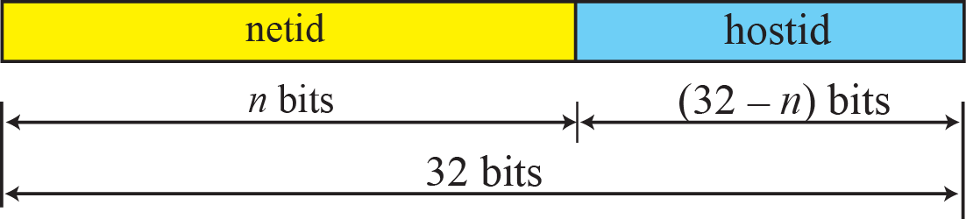
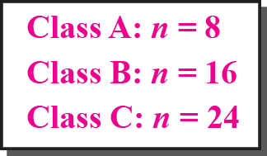
Cont.

Slide 20
Class- A Addresses
Class A IP addresses use the 1st 8 bits (1st Octet) to designate the Network address.
The 1st bit which is always a 0, is used to indicate the address as a Class A address & the remaining 7 bits are used to designate the Network.
The other 3 octets contain the Host address.
There are 128 (2⁷) Class A Network Addresses, but because addresses with all zeros aren’t used & address 127 is a special purpose address, 126 Class A Networks are available.

Slide 21
Cont.
There are 16,777,214 Host addresses available in a Class A address.
Rather than remembering this number exactly, you can use the following formula to compute the number of hosts available in any of the class addresses, where “^{n}” represents the number of bits in the host portion:
(2^{n} – 2) = Number of available hosts
When calculating hosts' IP addresses, 2 IP addresses are decreased because they cannot be assigned to hosts, i.e. the first IP of a network is network number and the last IP is reserved for Broadcast IP.

Slide 22
Cont.
For a Class A network, there are:
2²⁴ – 2 or 16,777,214 hosts.
Half of all IP addresses are Class A addresses.
You can use the same formula to determine the number of Networks in an address class.
Eg., a Class A address uses 7 bits to designate the network, so (2⁷ – 2) = 126 or there can be 126 Class A Networks.

Slide 23
Cont.
    |_| first one bit is used to determine the class to which an address belongs to for Class A address.
    |_______| 7 bits are used for Network address. Therefore, the number of class A networks can be 2⁷ = 128. Number 0 is not used, and number 127 is used for testing loopback for each host. There are 126 potential Class A network numbers, which have a first dotted decimal number in the range 1 to 126.
    |________________________| 24 bits are used for host address. Therefore, each Class A network can have 2²⁴ = 16,777,216 hosts.
    Class A is not available to the general public, and it is restricted to special uses.
    Class A final format:
    |_|_______| |________________________|
    7 bits 24 bits
    Network Host
    Part Part

Slide 24
Class B IP Addresses
Class B addresses use the 1st 16 bits (two octets) for the Network address.
The last 2 octets are used for the Host address.
The 1st 2 bit, which are always 10, designate the address as a Class B address & 14 bits are used to designate the Network. This leaves 16 bits (two octets) to designate the Hosts.
So how many Class B Networks can there be?
Using our formula, (2¹⁴ – 2), there can be 16,382 Class B Networks & each Network can have (2¹⁶ – 2) Hosts, or 65,534 Hosts.

Slide 25
Cont.
|__| first two (2) bits are used to determine the class to which an address belongs to for class B address.
|______________| 14 (6 + 8) bits are used for network address. Therefore, the number of class B networks can be 2¹⁴ = 16,384. There are 16,384 potential Class B network numbers, which have a first dotted decimal number in the range 128 to 191.
|________________| last 16 bits are used for host address. Therefore, each Class B network can have 2¹⁶ = 65,536 hosts.

Slide 26
Cont.
Class B final format
|__|______|________| |________________|
14 bits Network part 16 bits Host part
Summary:
If the first decimal number in IP address is 128 to 191, then it is a class B address.
The first two bytes identify the network.
The last two bytes identify the host.

Slide 27
Class C IP Addresses
Class C addresses use the 1st 24 bits (three octets) for the Network address & only the last octet for Host addresses.
The 1st 3 bits of all class C addresses are set to 110, leaving 21 bits for the Network address, which means there can be 2,097,150 (2²¹ – 2) Class C Networks, but only 254 (2⁸ – 2) Hosts per Network.

Slide 28
Cont.
    |___| first three (3) bits are used to determine the class to which an address belongs to for class C address.
    |_____|________|________| 21 (5 + 16) bits are used for network address. Therefore, the number of class C networks can be 2²¹ = 2, 097,152. There are 2,097,152 potential Class C network numbers, which have a first dotted decimal number in the range 192 to 223.
    |________| 8 bits are used for host address. Therefore, each Class C network can have 2⁸ = 256 hosts.

Slide 29
Cont.
  Class C final format
    |___|_____| |________| |________| |________|
    21 bits Network part 8 bits host part
    Summary:
    If the first decimal number in IP address is 192 to 223, then it is a class C address.
    The first three bytes are for the network address.
    The last 1 byte is for the host number.

Slide 30
Classes and Blocks
One problem with classful addressing is that each class is divided into a fixed number of blocks with each block having a fixed size as shown in Table.
Class | Net Id | Host Id | Number of Blocks/ Networks | Block size/ Address per block | Start address | End Address | Application
A | 8 | 24 | 128(2⁷) | 16,777,216(2²⁴) | 0.0.0.0 | 127.255.255.255 | Unicast
B | 16 | 16 | 16384(2¹⁴) | 65536(2¹⁶) | 128.0.0.0 | 191. 255.255.255 | Unicast
C | 24 | 8 | 2097152(2²¹) | 256(2⁸) | 192.0.0.0 | 223. 255.255.255 | Unicast
D | Not define | - |  |  | 224.0.0.0 | 239. 255.255.255 | Multicast
E | Not define | - |  |  | 240.0.0.0 | 255. 255.255.255 | Multicast

Slide 31
Cont.
Class A addresses were designed for large organizations with a large number of attached hosts or routers. Class B addresses were designed for midsize organizations with tens of thousands of attached hosts or routers. Class C addresses were designed for small organizations with a small number of attached hosts or routers.
We can see the flaw in this design. A block in class A address is too large for almost any organization. This means most of the addresses in class A were wasted and were not used. A block in class B is also very large, probably too large for many of the organizations that received a class B block. A block in class C is probably too small for many organizations

Slide 32
Netid and Hostid
Q-Given the network address 17.0.0.0 find the class, the block or net ID, and range of the address.
  Ans: Class A (Because: 0-127)
  The block has a net ID of 17
  The addressing range from 17.0.0.0-17.255.255.255
Q-Given the network address 132.21.0.0 find the class, the block or net ID, and range of the address.
  Ans: Class B(Because: 128-191)
  The block has a net ID of: 132.21
  The addressing range from: 132.21.0.0 -132.21.255.255

Slide 33
Address Depletion
The flaws in classful addressing scheme combined with the fast growth of the Internet led to the near depletion of the available addresses. Yet the number of devices on the Internet is much less than the 2³² address space. We have run out of class A and B addresses, and a class C block is too small for most midsize organizations.
One solution that has alleviated the problem is the idea of classless addressing.

Slide 34
Classless Addressing
To overcome address depletion and give more organizations access to the Internet, classless addressing was designed and implemented.
In this scheme, there are no classes, but the addresses are still granted in blocks.

Slide 35
Address Blocks
In classless addressing, when an entity, small or large, needs to be connected to the Internet, it is granted a block (range) of addresses.
The size of the block (the number of addresses) varies based on the nature and size of the entity.
  For example, a household may be given only two addresses; a large organization may be given thousands of addresses. An ISP, as the Internet service provider, may be given thousands or hundreds of thousands based on the number of customers it may serve.

Slide 36
Restriction
To simplify the handling of addresses, the Internet authorities impose three restrictions on classless address blocks:
The addresses in a block must be contiguous, one after another.
The number of addresses in a block must be a power of 2 (1, 2, 4, 8, ... ).
The first address must be evenly divisible by the number of addresses.

Slide 37

Cont.
A block of 16 addresses granted to a small organization. We can see that the restrictions are applied to this block. The addresses are contiguous. The number of addresses is a power of 2 (16 = 2⁴), and the first address is divisible by 16. The first address, when converted to a decimal number, is 3,440,387,360, which when divided by 16 results in 215,024,210.

Slide 38
Conversion
IP address to decimal
The designers of the IPv4 address decided to use decimal numbers 0 to 255 as symbols and to distinguish between the symbols, a dot (.) is used. The dot is used to separate the symbols; it marks the boundary between the positions. For example, the IPv4 address 131.32.7.8 is made of the four symbols 8, 7, 32, and 131 at positions 0, 1,2, and 3, respectively.
Weights:
In base 256, each weight equals 256 raised to the power of its position. The weight of the symbol at position 0 is 256⁰ (1); the weight of the symbol at position 1 is 256¹
(256); and so on.

Slide 39
Cont.
132. 17. 8. 14
IPv4 address
256³ 256² 256¹ 256⁰
Weights
2214592512 1114112 2048 14
Results
+
2,215,708,686
Decimal number

Slide 40
Mask
The mask can help us to find the netid and the hostid.
For example, the mask for a class-A address has (8)eight 1s, which means the first 8 bits of any address in class A
define the netid; the next 24 bits define the hostid.
Class | Binary | Dotted-Decimal | CIDR
A | 11111111 00000000 00000000 00000000 | 255.0.0.0 | /8
B | 11111111 11111111 00000000 00000000 | 255.255.0.0 | /16
C | 11111111 11111111 11111111 00000000 | 255.255.255.0 | /24

Slide 41
Cont.
Although the length of the netid and hostid (in bits) is predetermined in classful addressing, we can also use a mask.
Default Mask:
Class | Dotted-Decimal | Mask
A | 255.0.0.0 | /8 Example: 10.25.11.27/8
B | 255.255.0.0 | /16 Example: 192.25.11.27/16
C | 255.255.255.0 | /24 Example: 224.25.11.27/24

Slide 42
Cont.
The last column of Table shows the mask in the form /n where n can be 8, 16, or 24 in classful addressing. This notation is also called slash notation or Classless Interdomain Routing (CIDR) notation. The notation is used in classless addressing.

